Slide 1

Strings
Programming Principles in Python
Samuel A.

Slide 2
Recap
Source Code
The Anatomy of a Source Code
Keywords
Identifiers
Basic Data Types
Complex Data Types
Variables
Constants
Literals
Punctuations/Symbols
Operators
Comments
Whitespace and Tabs

Slide 3
WK 4 Lecture 4.1 Strings

Slide 4
Outline
Introduction to Strings
String Methods
String Operations
String Manipulation Techniques
Miscellaneous topics

Slide 5
Outline
Introduction to Strings
String Operations
String Methods
String Manipulation Techniques
Miscellaneous topics

Slide 6
Definition
A string is a sequence of characters that represents text. In Python, a string is a series of characters enclosed in either single quotes (' ') or double quotes (" ").
name = 'Shelton' name_2 = "Shelton"

Slide 7
How to create a string?
Strings can be created in several ways, including:
Assigning a string literal to a variable:
Converting other data types to strings using the str() function:
Using triple quotes to create multiline strings:
my_string = "Hello World"
my_string_int = str(123)
my_string_multiline = """This is a multiline string"""

Slide 8
String Literals
String literals are the actual characters that make up a string. They can include alphanumeric characters, whitespace, and special characters. For example:
my_string1 = "Hello World"
my_string2 = "Python is awesome!"
my_string3 = "I can use special characters like \\n to create new lines."
Notes:
my_string1 = "Hello World" is a string literal my_string2 = "Python is awesome!" is another string literal my_string3 = "I can use special characters like \\n to create new lines." uses a special character (\n) to create a new line in the string.

Slide 9
String Indexing
Strings are indexed starting at 0, which means that the first character in the string is at index 0, the second character is at index 1, and so on.
Indexing is done using square brackets [ ]. For example, in the string "Hello World", the character 'H' has an index of 0 and the character 'd' has an index of 10.

Slide 10
String Slicing
Slicing is used to extract a part of a string. It is done using the colon : operator. For example, in the string "Hello World", the slice [0:5] would return "Hello", while the slice [6:] would return "World".

Slide 11
Outline
Introduction to Strings
String Operations
String Methods
String Manipulation Techniques
Miscellaneous topics

Slide 12
String operations
String Concatenation
String repetition
String Length
Negative Indexing
String Comparison
String membership testing
Regular expressions

Slide 13
String Concatenation
You can concatenate strings using the + operator. For example, "Hello " + "World" would return the string "Hello World".
Name = 'Suzannah Smyth' Description = 'My name is '
Full_Sentence = Description + Name
print(Full_Sentence)
>>> My name is Suzannah Smyth

Slide 14
String Repetition
You can repeat a string by using the * operator.
For example: would return the string
print('Hello ' * 3)
>>> Hello Hello Hello

Slide 15
String length
You can find the length of a string using the len() function.
For example, would return 9.
print(len('Jim Corro'))

Slide 16
Negative Indexing
In addition to positive indexing, you can also use negative indexing to access characters from the end of a string.
For example, in the string the character ‘l' can be accessed using the index -1.
'Gabriel'

Slide 17
String Comparison
You can compare strings using the == and != operators to test if they are equal or not equal, respectively.
For example, would return True,
while
would also return True.
"Hello" == "Hello"
"Hello" != "Hello World"

Slide 18
String Membership
You can use the in and not in operators to test if a substring is a member of a string or not.
For example, would return True, while
would also return True.
"ell" in "Hello"
“world“ not in "Hello"

Slide 19
Regular expressions
Regular expressions are a powerful way to search for and manipulate text in strings. Python provides a module called re for working with regular expressions. Some commonly used functions and methods include:
search(): Search the string for a match to a regular expression pattern.
match(): Match the regular expression pattern at the beginning of the string.
findall(): Find all matches to the regular expression pattern in the string.
sub(): Replace all occurrences of the regular expression pattern in the string with a specified replacement.

Slide 20
Expressions
search(): This function searches for the first occurrence of a regular expression pattern in a string and returns a match object if found. The search starts from the beginning of the string by default, but you can use the start parameter to specify the starting position of the search. If the pattern is not found, None is returned.
match(): This function checks if the regular expression pattern matches at the beginning of a string and returns a match object if found. If the pattern is not found at the beginning of the string, None is returned.
findall(): This function finds all non-overlapping occurrences of a regular expression pattern in a string and returns a list of matching substrings. If the pattern is not found, an empty list is returned.
sub(): This function replaces all occurrences of a regular expression pattern in a string with a specified replacement string and returns the modified string. You can use the count parameter to limit the number of replacements that are made. If the pattern is not found, the original string is returned unchanged

Slide 21
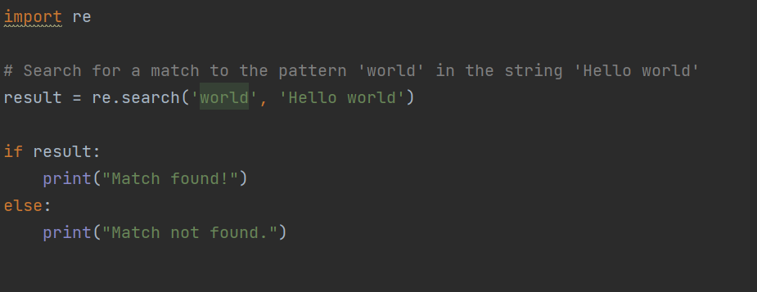
Regular Expression: Search

Slide 22
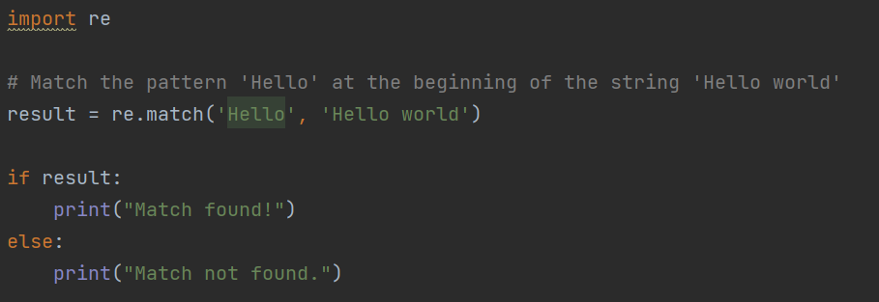
Regular Expression: match

Slide 23
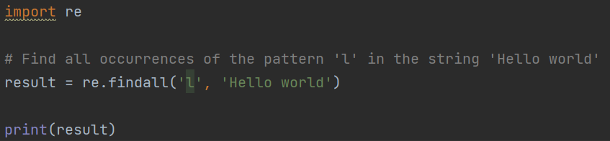

Regular Expression: findall

Slide 24
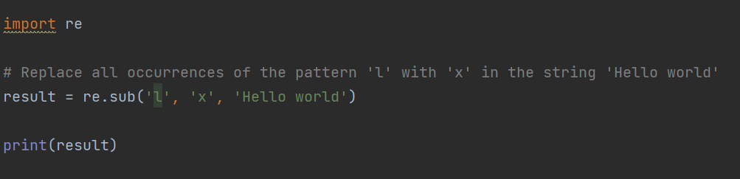

Regular Expression: sub

Slide 25
Outline
Introduction to Strings
String Operations
String Methods
String Manipulation Techniques
Miscellaneous topics

Slide 26
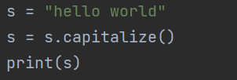

String Methods: Capitalize
capitalize(): Capitalize the first character of a string

Slide 27
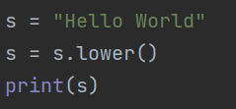

String Methods: lower
lower(): Convert all characters in a string to lowercase

Slide 28
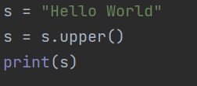

String Methods: upper
upper(): Convert all characters in a string to uppercase

Slide 29
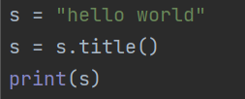

String Methods: title
upper(): Capitalize the first character of each word in a string

Slide 30
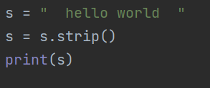
String Methods: strip
strip(): Remove whitespace characters from the beginning and end of a string

Slide 31
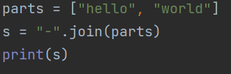

String Methods: join
join(): Concatenate a list of strings into a single string with a specified separator

Slide 32
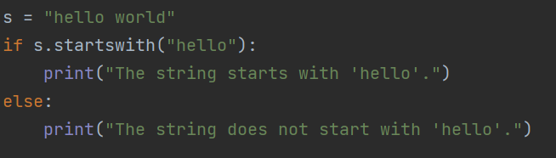

String Methods: startswith
startswith(): Check if a string starts with a specified substring

Slide 33
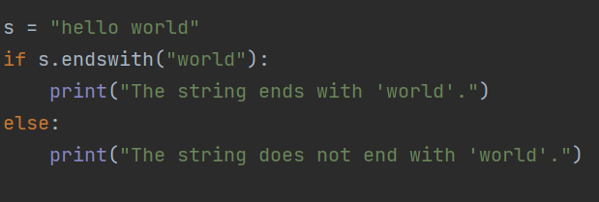

String Methods: endswith
endswith(): Check if a string ends with a specified substring

Slide 34
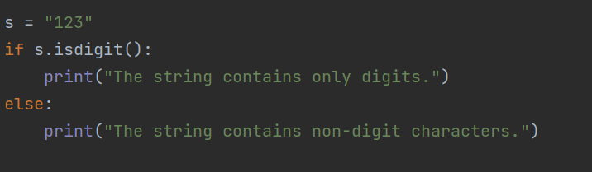
String Methods: isdigit
isdigit(): Check if a string contains only digits

Slide 35
Outline
Introduction to Strings
String Operations
String Methods
String Manipulation Techniques
Miscellaneous topics

Slide 36
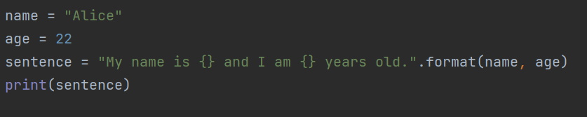
Formatting Strings
Using the format() method
The format() method allows you to format a string by inserting values into placeholders. Placeholders are represented by curly braces { } in the string. The format() method takes the values to be inserted as arguments.

Slide 37
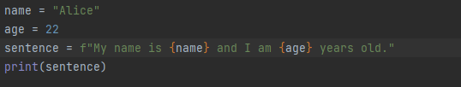
Formatting Strings
Using f-strings
f-strings are a more recent addition to Python (introduced in Python 3.6) and provide a more concise way to format strings. To create an f-string, you prefix the string with the letter "f" and use curly braces {} to indicate placeholders for variables.

Slide 38

Formatting Strings
Using str.format_map()
The format_map() method allows you to format a string using a dictionary. The keys of the dictionary are used as placeholders in the string, and the values are inserted into those placeholders.

Slide 39
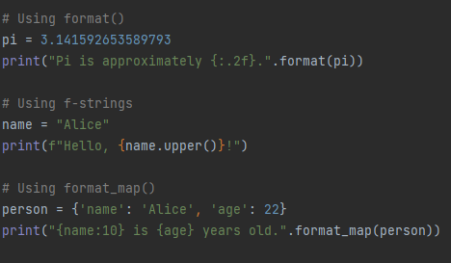

A note on String formatting
All three methods support a wide range of formatting options, such as specifying the number of decimal places for floating point numbers or padding strings with zeroes or spaces. Here are some examples:

Slide 40
Outline
Introduction to Strings
String Operations
String Methods
String Manipulation Techniques
Miscellaneous topics

Slide 41

Miscellaneous
Encoding and decoding of strings using Unicode:
In Python, strings are represented internally as Unicode characters. When working with text data that needs to be transmitted over a network or stored in a file, it's often necessary to encode the string in a particular format. Here's an example of encoding a string to UTF-8:

Slide 42


Miscellaneous
Encoding and decoding of strings using Unicode:
To decode the encoded string, you can use the ‘decode()’ method:

Slide 43

Miscellaneous
Byte strings and byte arrays:
Byte strings and byte arrays are similar to regular strings and arrays, but they represent data as a sequence of bytes instead of characters. Byte strings are immutable, while byte arrays are mutable. Here's an example of creating a byte string:

Slide 44

Miscellaneous
Byte strings and byte arrays:
To create a byte array, you can use bytearray() function

Slide 45
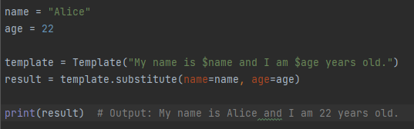
Miscellaneous
String interpolation with templates:
String templates provide a way to substitute variables into a string using a specific syntax. The string module provides support for string templates in Python. Here's an example of using a string template to interpolate a variable:

Slide 46
Outline
Introduction to Strings
String Operations
String Methods
String Manipulation Techniques
Miscellaneous topics

Slide 47

Thank you

